Slide 1
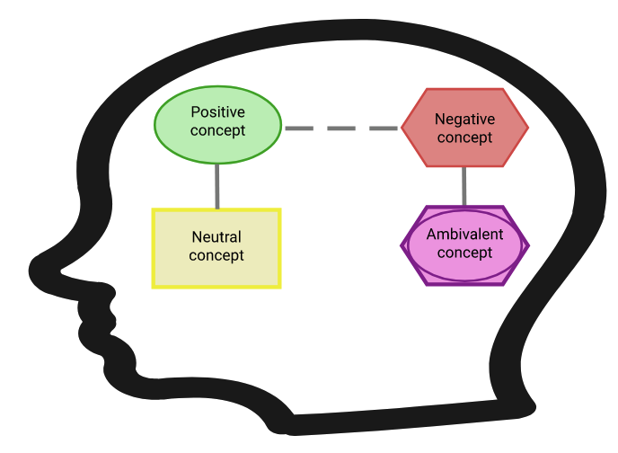
Software Testing
to improve the Cognitive-Affective Map tools
Notes:
Welcome to our journey into the world of software testing to improve the Cognitive-Affective Map tools. Together, we'll unlock the secrets to craft flawless applications, transforming obstacles and bugs into stepping stones towards excellence.

Slide 2
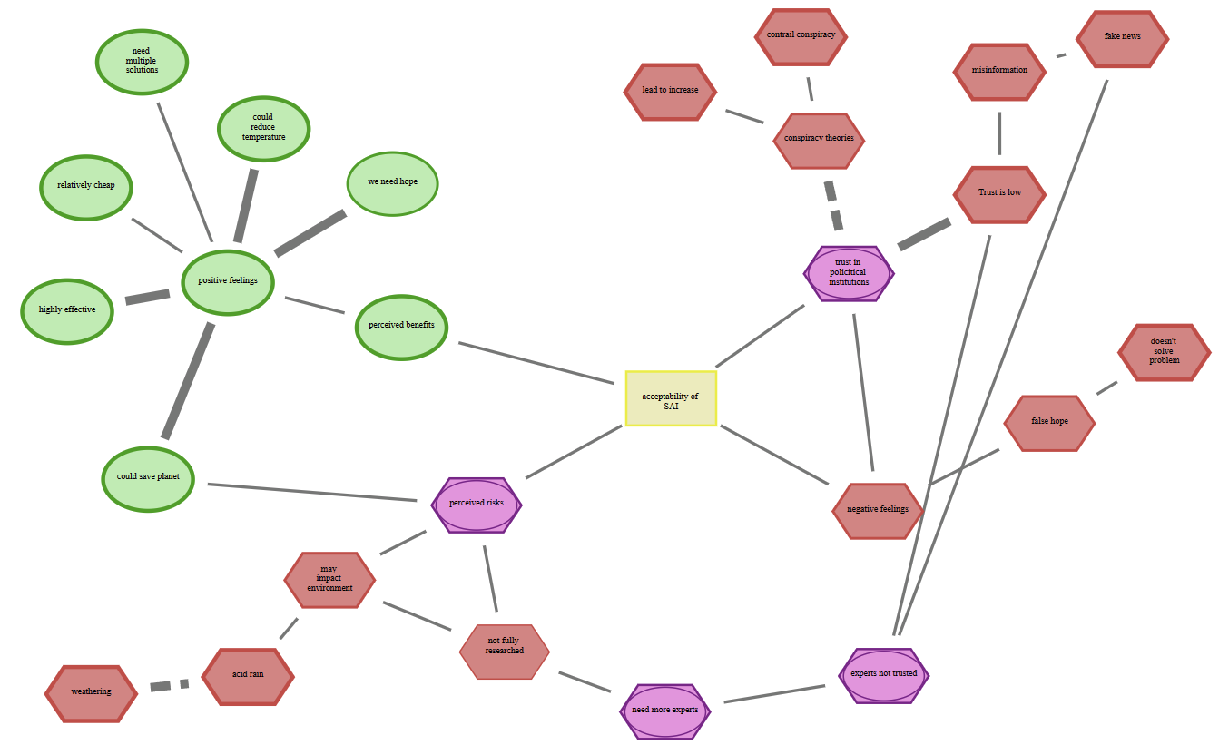
Cognitive-Affective Maps (CAMs)
Fenn, J., Helm, J. F., Höfele, P., Kulbe, L., Ernst, A., & Kiesel, A. (2023). Identifying key-psychological factors influencing the acceptance of yet emerging technologies–A multi-method-approach to inform climate policy. PLOS Climate, 2(6), 1–25. https://doi.org/10.1371/journal.pclm.0000207
Notes:
Cognitive-Affective Maps (CAMs) are both a qualitative and quantitative research tool, made popularized by the philosopher Paul Thagard , and act as a specific form of mind maps.
CAMs consist of concepts linked by connections, which a freely drawn by a participant
Thereby concepts featuring affective valences to indicate a person's positive (green), negative (red), neutral (yellow), or ambivalent (purple) emotional associations.
Connections within CAMs can vary in strength and are represented as solid lines for supportive relationships and dashed lines for inhibitory relationships.
To collect and analyze these data we have developed tools…

Slide 3
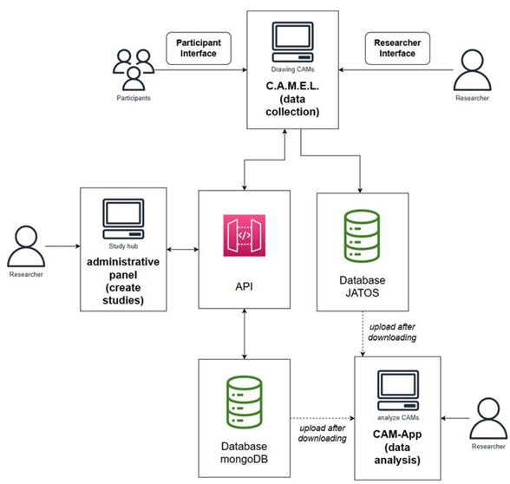
Developed tools for Cognitive-Affective Mapping
Central web page: https://drawyourminds.de
General information on the developed tools; possible to set-up CAM studies without the need for programming
Online documentation: https://osf.io/q5hj4/
Detailed documentation of developed CAM tools and explanations for how to set up studies with multiple examples; thematically sorted CAM literature
GitHub: https://github.com/Camel-app
All the code of the programmed CAM tools:
Data Collection: Cognitive-Affective Map Extended Logic (C.A.M.E.L.)
Data Analysis: CAM-App
Web page
Notes:
Three tools where developed one to
Collect data, which is called Cognitive-Affective Map Extended Logic (C.A.M.E.L.). CAMEL is an open-source software to draw Cognitive-Affective Maps and it aims to offer people an easy and intuitive interface on which they could draw their own mind map within online studies. There is a participant view and a researcher view to set up studies and it is possible to change over multiple parameters of the C.A.M.E.L. software (e.g. force to full screen, or change language to Chinese) to adapt CAM studies.
Another tool aims to analyze the resulting data, which is called CAM-App. Here we a using multiple modules to summarize your CAM data semi-automatically (e.g. sophisticated language models are implemented) and the so summarized can subsequently be analyzed, for example by aggregating CAMs or compute over 30 network indicators.
Finally there is an webpage to set up and configure CAM studies without the need of coding.

Slide 4




Our goal
Software debugging of developed CAM tools
Data Collection: Cognitive-Affective Map Extended Logic (C.A.M.E.L.)
Data Analysis: CAM-App
administrative panel (webpage)
> after debugging and improving these tools it will be finally deployed on the bwCloud
Collection of suggestions for possible improvements and extensions of the tools
Notes:
Our goal is now to debug these three developed tools. Thereby software debugging is the process of identifying, analyzing, and removing errors, bugs, or abnormalities in computer software. It involves the use of specialized tools, techniques, and strategies to ensure that the software performs as intended and meets its design specifications.
After these tools have been improved and bug fixed we will deploy the to a university cluster.
This process is of most importance, because already around 20 researchers currently using these tools.

Slide 5
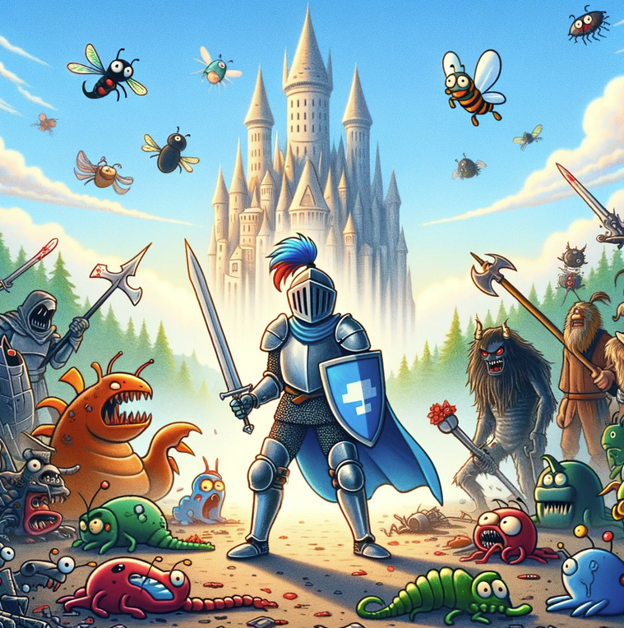
Being a great software tester
You are a valiant knight combating bugs and glitches to protect the integrity of software.
Be a
Hero
Embrace your critical role
(OpenAI, 2024)
Notes:
Imagine you are a valiant knight combating bugs and glitches to protect the integrity of software and your central task is to notice weird and unexpected behaviour of our developed CAM tools and know how to document such behaviour and at best you should be able to reproduce it. I want to encourage you to try and provoke unintended ways of using these tools (like entering things that are clearly not supposed to be there).
Before explaining your central task I would like to explain you some technical fundamentals of browsers.

Slide 6
Technical fundamentals of browsers
Notes:
Understanding the fundamentals of browsers, including HTML, CSS, and JavaScript, is crucial for software testing. This knowledge allows you as testers to effectively analyze web applications, identify potential issues in the user interface, and understand how changes in code affect functionality and user experience. Finally it even enables the creation of more accurate, automated test scripts and helps in debugging issues, ensuring the delivery of high-quality, robust web applications to improve our CAM tools.

Slide 7
Building blocks of web pages
Technology | Role in Web Development | Key Characteristics | Examples
HTML (HyperText Markup Language) | Defines the structure and content of web pages. | - Uses tags to denote elements such as headings, paragraphs, links; forms the skeleton of the web page. | <h1>Title</h1> <p>This is a paragraph.</p>
CSS (Cascading Style Sheets) | Styles the visual presentation of web pages. | - Controls layout, colors, fonts. - Separate from HTML to allow design changes without altering the structure. | <p style="color:blue">This is a paragraph</p>
JavaScript | Adds interactivity and dynamic content to web pages. | - Can manipulate both HTML and CSS. - Enables responsive and interactive web elements. | document.getElementById("demo").innerHTML = "Hello JavaScript!"; alert("Hello World");
Notes:
To briefly summarize the building blocks of web pages:
HTML is used to create the basic structure of web pages, allowing browsers to display content.
CSS is applied to HTML to style and layout web pages, enhancing the visual appeal.
JavaScript brings web pages to life by adding functionality and interactivity.
Together, these technologies allow developers to build complex, interactive, and visually appealing web sites and applications. While HTML lays the foundation, CSS enhances aesthetics, and JavaScript introduces interactivity, showing the synergy between structure, presentation, and behavior in web development.

Slide 8
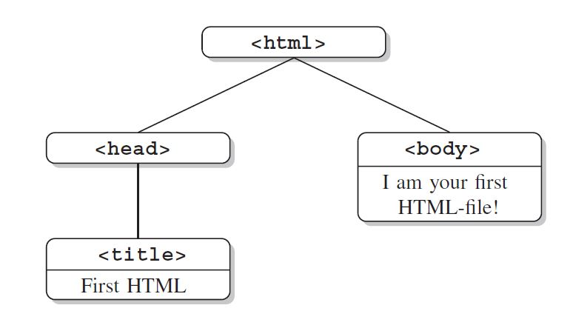
.html: tree-structure
<!DOCTYPE html>
<html>
<head>
<title>First HTML</title>
</head>
<body>
I am your first HTML file!
</body>
</html>
From Munzert, S., Rubba, C., Meißner, P., & Nyhuis, D. (2015). Automated Data Collection with R: A Practical Guide to Web Scraping and Text Mining. John Wiley & Sons; Figure 2.5.
Notes:
An HTML document is like a family tree with different members, each playing their own role:
<!DOCTYPE html>: This is like telling everyone we're going to speak in "HTML language". It's not really part of the family, but it sets the stage.
<html>: This is the grandparent of all the other elements. It wraps around everything else in the document.
<head>: This section is like the brain. It contains information about the document, but not the content people see directly. In this case, it holds a <title> tag.
<title>: This is a specific thought inside the head, naming the document. Here, it's called "First HTML".
<body>: This is where the document's visible content lives, kind of like the body that does all the action. Here, it says, "I am your first HTML file!"
Each member is nested inside the other, creating a clear hierarchy or "family structure".

Slide 9
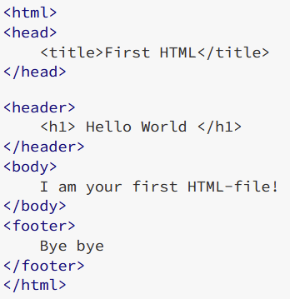
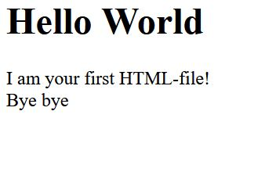
.html
Hypertext Markup Language, first proposed by Tim Berners-Lee (1989), central agency: World Wide Web Consortium
Notes:
If we would now compile these HTML code and add a footer, which represents content at the buttom of a page, we would get the following result.

Slide 10
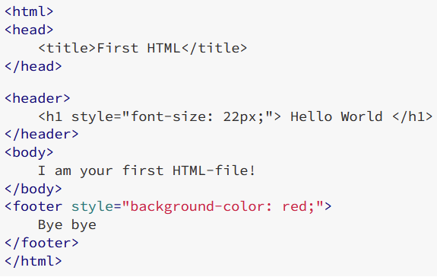
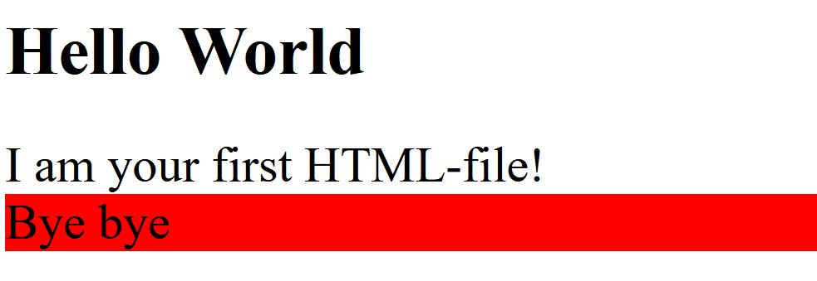
.css
Cascading Style Sheets: a language for describing the layout of HTML (and other markup documents)
Notes:
CSS as explained is applied to HTML to style and layout web pages.
The style argument makes the background of this footer section red, so the "Bye bye" message will appear with a red backdrop, making it stand out.

Slide 11
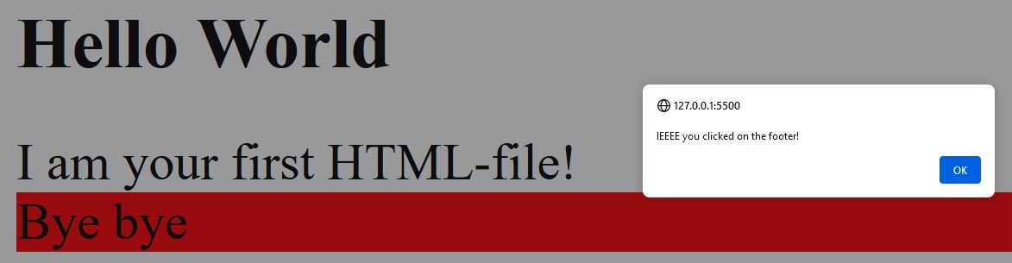
.js
JavaScript: allows the browser to change the content and structure of the document after it has been loaded from the server, enabling user interaction and event handling
document.querySelector('footer').addEventListener("click", () => {
alert('IEEEE you clicked on the footer!');
})
Notes:
Now JavaScript brings web pages to life by adding functionality and interactivity.
This code here waits for someone to click on the footer section of a webpage. When someone clicks the footer, a small pop-up message will appear that says, 'IEEEE you clicked on the footer!'. It's like setting up a fun surprise for anyone who decides to click on that bottom part of the page.

Slide 12
.js: DOM event types
mouse events: mousedown, mouseup, click, dblclick, mousemove, mouseover, mousewheel, mouseout, contextmenu
touch events: touchstart, touchmove, touchend, touchcancel
keyboard events: keydown, keypress, keyup
form events: focus, blur, change, submit
window events: scroll, resize, hashchange, load, unload
…
used eventListeners to build up the interactive parts for users: https://camgalaxy.github.io/
Notes:
In the world of web pages, event listeners like the previous one are like little spies you place on different parts of a page (like buttons, images, or the footer) to watch for specific actions by visitors. These actions are called "events."
Events can be many things: someone clicking a mouse button, pressing a key on the keyboard, moving the mouse over an element, or even loading the page itself.
When an event listener detects its specific event, it triggers a response you've set up, like displaying a message.
Basically combining multiple event listeners enabled us to created the Cognitive-Affective Map Extended Logic (C.A.M.E.L.) to collect data.

Slide 13
Using JavaScript in Your Browser
Step 1: Open Your Browser's Developer Console
Instructions:
For Chrome, Firefox, or Edge: Press Ctrl+Shift+J (Windows/Linux) or Cmd+Option+J (Mac).
For Safari: Enable the Develop menu in Safari's Advanced preferences, then press Cmd+Option+C.
Purpose: The console is a tool that developers use to log information as part of the JavaScript development process. It's also where you can run JavaScript code directly.
Step 2: Write or Paste Your JavaScript Code
Instructions: Click into the console, type your JavaScript code, or paste code you've copied. For example, try console.log('Hello, world!');.
Purpose: To see how JavaScript can output data to the console. This is a basic way to start interacting with JavaScript.
Step 3: Execute Your Code
Instructions: Press Enter to run your code.
Purpose: This step runs your JavaScript code. If you used the example code, you should see "Hello, world!" printed in the console.
Notes:
If you want now to look under the hood of your browser you can open the so called “console”, which I will show you on the next slide.

Slide 14

Hands on technical fundamentals of browsers
to get a basic understanding of the technical fundamentals of browsers
Play around on http://example.org/
all shown examples are on GitHub:
https://github.com/FennStatistics/Project_testingCAMtools/tree/main/hands%20on%20browser
if you want to play around with the shown examples you could, install Visual Studio Code (https://code.visualstudio.com/) and the "live server" extension and click on "Go Live" at the bottom right

Slide 15
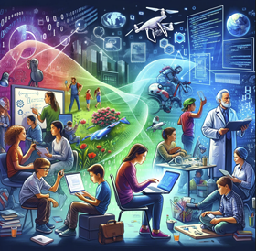
Learning Materials - Web Development
Online Courses:
freeCodeCamp [free]: https://www.freecodecamp.org/
codecademy: https://www.codecademy.com/catalog
udemy - Modern JavaScript: https://www.udemy.com/course/modern-javascript-from-novice-to-ninja/
Online Documentations / AI:
W3Schools: https://www.w3schools.com/html/default.asp
ChatGPT: https://openai.com/chatgpt
using programming to innovate, solve problems, and harness technology's potential (picture created by OpenAI, 2024)
Notes:
If you would like to learn the basics of web development yourself, here are some links that I used to teach myself this skill.

Slide 16
Learning Materials - Web Development
YouTube Channels:
Web Dev Simplified: https://www.youtube.com/@WebDevSimplified
Net Ninja: https://www.youtube.com/@NetNinja
Fireship: https://www.youtube.com/@Fireship
Dani Krossing: https://www.youtube.com/@Dani_Krossing
Books:
Haverbeke, M. (2024). Eloquent JavaScript, 4rd Edition: A Modern Introduction to Programming. No Starch Press. https://eloquentjavascript.net/
using programming to innovate, solve problems, and harness technology's potential (picture created by OpenAI, 2024)
Notes:
Extremly helpfull are YouTube channels from professional web developers.

Slide 17
Importance?!
Static vs. Dynamic Web Pages
Feature | Static Web Pages | Dynamic Web Pages
Content | Fixed content | Content changes dynamically
Load Time | Generally faster | Can be slower due to processing
User Interaction | Limited interactivity | Highly interactive
Technologies | HTML, CSS | HTML, CSS, JavaScript, Server-side languages
price discrimination
products recommendation; Linden, G., Smith, B., & York, J. (2003). Amazon.com recommendations: Item-to-item collaborative filtering. IEEE Internet Computing, 7(1), 76–80. https://doi.org/10.1109/MIC.2003.1167344
Notes:
You could ask yourself why is a understanding of webpages for your personal life important?
If you looking for a flight or you buying products in an online warehouse, you are normally confronted with dynamic web pages.
Price discrimination occurs when a business or seller sets varying prices for the same product or service, tailored to different customer groups. For example, flights are sometimes more expansive if you book them using an Apple product, because it could be assumed that people who using Apple have more money.
Another important area are individualized product recommendations, which make up a large part of Amazon's profits.
Such price changes or different product recommendations are only possible on dynamic web pages, which is basically driven by Java Script frameworks and other programming languages in the background.

Slide 18


Software testing
Notes:
Now I want to give you an overview over software testing, whereby I focused on the following two books [read] and multiple articles which I will reference on the single slides.

Slide 19
Software Engineering vs. Programming
Aspect | Software Engineering | Programming
Definition | A systematic, disciplined, and quantifiable approach to the development, operation, and maintenance of software. | The process of writing, testing, and maintaining the code in a software project.
Scope | Broad, covering the entire software development lifecycle including planning, management, design, development, testing, and maintenance. | Focused on the implementation phase, specifically the creation of code that meets software design specifications.
Objective | To ensure software is developed in a cost-effective, timely, and high-quality manner to meet or exceed stakeholder expectations. | To translate software design and specifications into operational software by writing and testing code.
Key Activities | Requirements analysis, system design, software architecture, project management, quality assurance, and maintenance. | Writing code, debugging, and performing unit testing to ensure functionality meets specified requirements.
Outcome | Delivering a complete software system that is efficient, reliable, and meets user needs. | Producing functional software components and modules as part of the larger system.
Notes:
In order to continuously improve the developed CAM tools and keep them bug, we are confronted with Software Engineering, which is a systematic approach to develop and maintain software.
You could imagine that Software Engineering is like overseeing the entire process of creating a building, from planning to construction to maintenance, making sure everything runs smoothly and meets needs. Programming, on the other hand, is like the actual construction phase, where the focus is on putting bricks together according to the plan. So, while programming is about writing and testing code, software engineering covers the big picture, including managing the project and making sure the software keeps working well after it's built.
There are central models describing the process of software development…

Slide 20
Phases of the Rational Unified Process
Inception Phase
Goal: Define the project's scope and business case.
Milestone: Lifecycle Objective Milestone (Project viability).
Elaboration Phase
Goal: Analyze project needs in detail and establish a solid architectural foundation.
Milestone: Lifecycle Architecture Milestone (Architectural baseline).
Construction Phase
Goal: Develop and test the software product iteratively.
Milestone: Initial Operational Capability Milestone (Product readiness).
Transition Phase
Goal: Deploy the software in the user environment and ensure stakeholder satisfaction.
Milestone: Product Release Milestone (Transition to maintenance).
(Ambler, 2005)
Notes:
The Rational Unified Process (RUP) is a detailed and structured approach for software development, which emphasizes iterative development, focusing on meeting requirements and building around a core architecture.
At the beginning, during the Inception phase, the main objectives are to align stakeholder expectations with the project's goals and secure the necessary funding.
In the Elaboration phase, the team details out the system requirements and validates the system architecture to ensure it can support these requirements.
The Construction phase is where the actual development takes place, aiming to bring the system to a point where it can be deployed. This phase concentrates on finalizing requirements, designing, coding, and testing the software according to these requirements.
Lastly, the Transition phase is about getting the system ready for real-world use. It involves rigorous testing by system testers and future users, making necessary adjustments, and preparing end users, support teams, and operations staff through training.
With the developed CAM tools we now want now to go a step back to the construction phase to improve these tools one step further.
The next model is the spiral model…

Slide 21
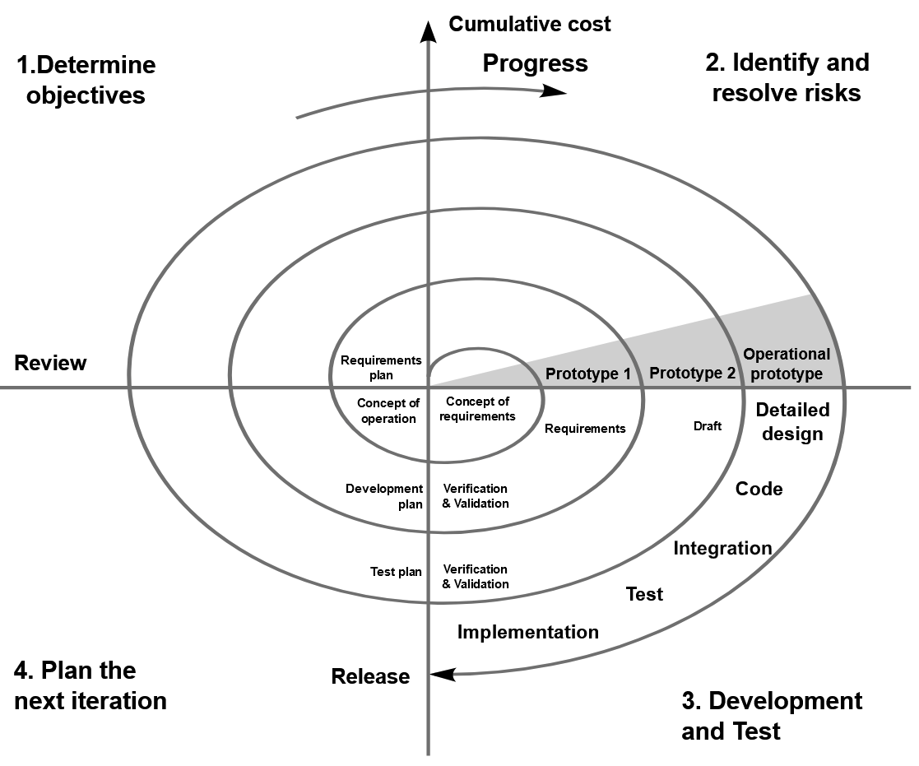
The Incremental Commitment Spiral Model
risk-driven process model
cyclic approach: repeating process that gradually adds more detail and functionality to a system, making it clearer and more complete over time while reducing potential problems or risks
milestones: key achievement markers to make sure everyone involved agrees on realistic and satisfactory ways to build the system
From Boehm, B. (1988). Spiral model. File:Spiralmodel_nach_Boehm.png, Spiral_model_(Boehm,_1988).png. https://commons.wikimedia.org/wiki/File:Spiral_model_(Boehm,_1988).svg
(Boehm & Hansen, 2001)
Notes:
The spiral model is like going around in circles where, with each turn, you add more details and parts to a project (software), making it more complete while making sure the risks or chances of something going wrong get smaller.
Risks are conditions or potential events that might prevent a project from achieving its objectives. Their severity can vary from minor to catastrophic, and their probability of happening can range from highly likely to nearly impossible.
It includes important checkpoints that make sure everyone involved agrees on what the project should look like and how to make it work well for everyone.
Such a process model answers two main questions: What should be done next? How long should it continue?
Your central task is now to identify existing risks in the developed tools, more precisely possible bugs…

Slide 22
Testing - with a focus on bug reports
Notes:
This leads now to your central task, testing these developed tools.
But first „What are bugs?“…

Slide 23
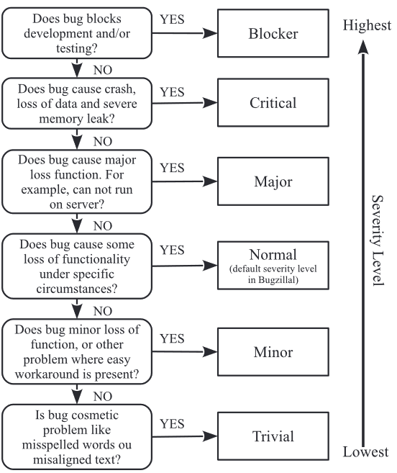
Bugs
In the context of software testing, a "bug" refers to an error, flaw, or fault in a software program that causes it to produce an incorrect or unexpected result, or to behave in unintended ways.
From Gomes, L. A. F., Torres, R. da S., & Côrtes, M. L. (2019). Bug report severity level prediction in open source software: A survey and research opportunities. Information and Software Technology, 115, 58–78. https://doi.org/10.1016/j.infsof.2019.07.009; Figure 2 (b)
(OpenAI, 2024)
Notes:
[read definition]
Anything deviating from what is required or expected from a software is a bug.
The severity of a bug ranks the seriousness of the issue, ranging from a blocker (meaning the application cannot be used) to trivial (indicating a minor visual flaw).

Slide 24
The Incremental Commitment Spiral Model is real
Maintaining software is an ongoing activity.
e.g., see lab.js releases:
https://github.com/FelixHenninger/lab.js/releases
From Boehm, B. (1988). Spiral model. File:Spiralmodel_nach_Boehm.png, Spiral_model_(Boehm,_1988).png. https://commons.wikimedia.org/wiki/File:Spiral_model_(Boehm,_1988).svg
(Boehm & Hansen, 2001)
Notes:
The maintenance of software is a continuous task, for example, how
Browsers compile HTML could and will change in the future
or there are update of Java Script libraries, which are included in our developed tools
It is estimated that more than 70% of a software product's total lifecycle expenses are dedicated to maintenance, which includes updating existing code, fixing bugs, and making improvements to the software.
As an example you could have a look in the documentation of the different releases of the online study tool lab.js.

Slide 25
Key characteristics of bug reports
Observed Behavior: The unexpected behavior witnessed by the user due to the bug. Users should describe what occurred with sufficient detail.
Expected Behavior: The user's anticipation of how the application should behave, contrasted with the actual observed behavior. Users should clarify their expectations, whether it's the absence of an error or the occurrence of a specific error that didn't happen as expected.
Steps to Reproduce: Detailed instructions for the developer to replicate the bug on their system. It's essential to include enough specifics so the issue can be reproduced elsewhere, without necessarily listing the steps in order.
Version: The specific version of the application being used (Browser) when the bug was encountered.
…
(Davies & Roper, 2014; Zimmermann et al., 2010); online bug-tracking tool: https://www.bugzilla.org/
Notes:
How would you now report a bug you have found in the developed CAM tools? For example, you would send a developer team the observed behavior, where you describe what have happened and how deviates it from the expected behavior. Ideally, you should also specify the steps for reproducing the error to make it easier for a web developer to resolve the error.
You do not need to remember such key characteristics of bug reports, because I created an online bug report template, which you can fill out when testing the individual tools. To set up this template I included these key characteristics and oriented myself to Bugzilla, which is an online bug-tracking tool developed by the Mozilla Foundation, which has developed, for example, the Firefox Browser.

Slide 26
Exact steps for bug reporting
download detailed explanations how to test the different tools from GitHub: https://github.com/FennStatistics/Project_testingCAMtools/tree/main/testing%20materials
set up your testing environment
use incognito (private browsing mode), which enables you to browse the internet without your browsing history, cookies, site data, or information entered being saved
open respective software (data collection, data analysis, administrative panel) and start testing
links provided in 1.
report bugs / possible improvements in the online survey: https://studien.psychologie.uni-freiburg.de/publix/7ENProF1bXN
Notes:
Now what are the exact steps to report bugs?

Slide 27
Hands on bug reporting
Example: data collection (C.A.M.E.L.)
download explanations from GitHub: https://github.com/FennStatistics/Project_testingCAMtools/tree/main/testing%20materials
set up your testing environment
open respective software
report bugs / possible improvements in the online survey: https://studien.psychologie.uni-freiburg.de/publix/7ENProF1bXN
Notes:
I would like to show you a bug I am already aware of [CAMEL-issue with arrows flipping if the concepts are too close] and show you how I discovered this bug, how I can reproduce it and how I would fill out the bug report].
Importantly the shown detailed explanation and the online bug report template can be change in the future if we have further developed our CAM tools.

Slide 28
Immerse yourself into exploratory software testing
Online Courses:
Testing the Burger King website | Exploratory Testing | QA: https://www.youtube.com/watch?v=aX42Qr0eeuI
see YouTube channel: https://www.youtube.com/@glitchitsystem/videos
picture created by OpenAI, 2024
Notes:
If the hands on example was to fast, I highly recommend to watch this YouTube video on exploratory testing to get into the right "mindset" to be a great software tester.

Slide 29
References

Slide 30
References
Ambler, S. W. (2005). A Manager’s Introduction to The Rational Unified Process (RUP). Ambysoft. https://people.computing.clemson.edu/~johnmc/courses/cpsc372/resources/managersIntroToRUP.pdf
Boehm, D. B., & Hansen, W. J. (2001). The Spiral Model as a Tool for Evolutionary Acquisition. Best Practices.
Cha, S., Taylor, R. N., & Kang, K. (2019). Handbook of Software Engineering. Springer.
Fenn, J., Helm, J. F., Höfele, P., Kulbe, L., Ernst, A., & Kiesel, A. (2023). Identifying key-psychological factors influencing the acceptance of yet emerging technologies–A multi-method-approach to inform climate policy. PLOS Climate, 2(6), 1–25. https://doi.org/10.1371/journal.pclm.0000207
Gomes, L. A. F., Torres, R. da S., & Côrtes, M. L. (2019). Bug report severity level prediction in open source software: A survey and research opportunities. Information and Software Technology, 115, 58–78. https://doi.org/10.1016/j.infsof.2019.07.009
Davies, S., & Roper, M. (2014). What’s in a bug report? Proceedings of the 8th ACM/IEEE International Symposium on Empirical Software Engineering and Measurement, 1–10. https://doi.org/10.1145/2652524.2652541
Linden, G., Smith, B., & York, J. (2003). Amazon.com recommendations: Item-to-item collaborative filtering. IEEE Internet Computing, 7(1), 76–80. https://doi.org/10.1109/MIC.2003.1167344
Munzert, S., Rubba, C., Meißner, P., & Nyhuis, D. (2015). Automated Data Collection with R: A Practical Guide to Web Scraping and Text Mining. John Wiley & Sons.
OpenAI ChatGPT. (2024). Knight battling bugs: A motivational illustration for software testers [Digital image]. Created March 19, 2024.
Winters, T., Manshreck, T., & Wright, H. (2020). Software Engineering at Google: Lessons Learned from Programming Over Time. O’Reilly Media, Inc.
Zimmermann, T., Premraj, R., Bettenburg, N., Just, S., Schroter, A., & Weiss, C. (2010). What Makes a Good Bug Report? IEEE Transactions on Software Engineering, 36(5), 618–643. https://doi.org/10.1109/TSE.2010.63

